Slide 1
Product Description

Slide 2
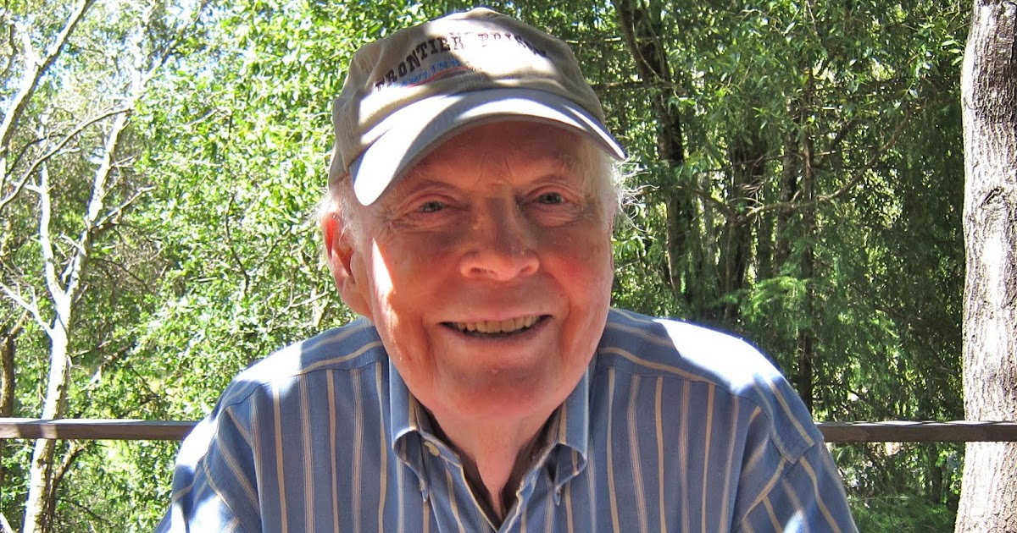
Background
Originally owned by Davis Bynum who called his wine BAREFOOT in 1965.
The name “ Barefoot” was chosen to honor the winemaking traditions of the past that often employed vinters crushing the grapes after harvest.
Bynum was also a fun guy who sought attention to his brand by drawing popularity from the well-established ones, like Rothchild’s Chateau Lafite, after which he tagged his brand,
“Chateau Le-FEET.”.

Slide 3
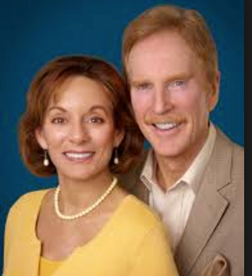
Background
The fun continues as he promoted these qualities in his wines: approachable, affordable, accessible. Barefoot sold familiarity, reliability and approachable quality.
In the 1980’s, Michael Houlihan and Bonnie Harvey took over from Mr. Bynum and started the Barefoot Cellars in the 80’s.

Slide 4
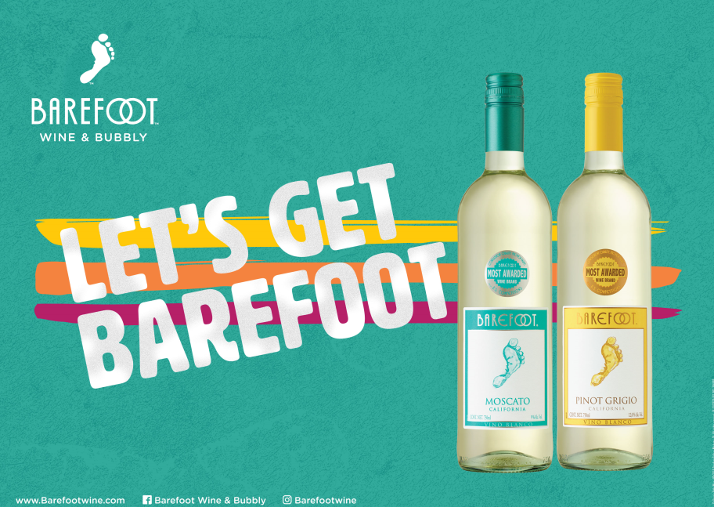
ICONIC BRAND

Slide 5
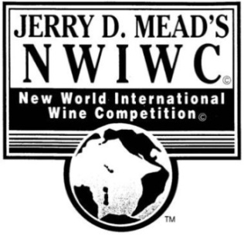
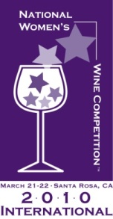
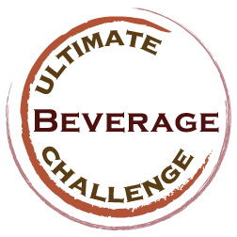
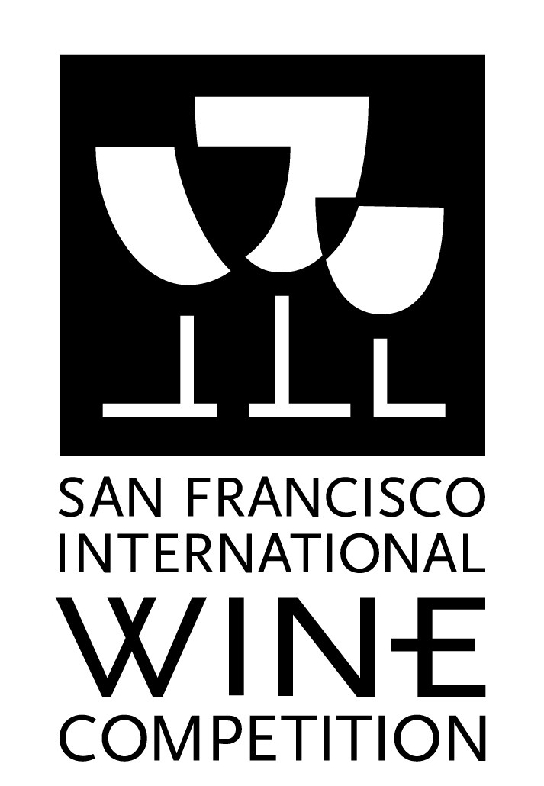
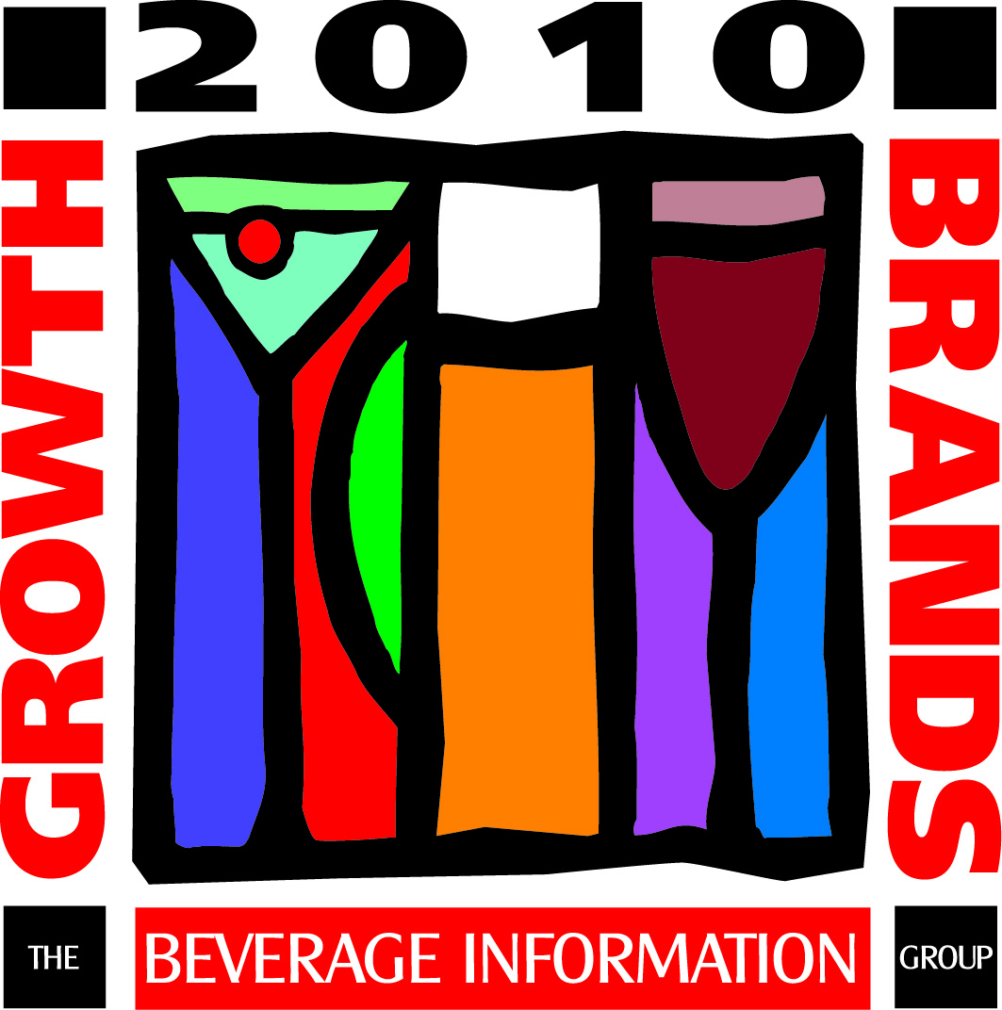
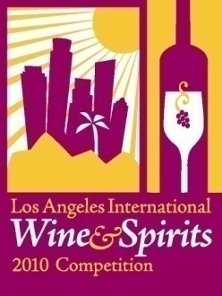
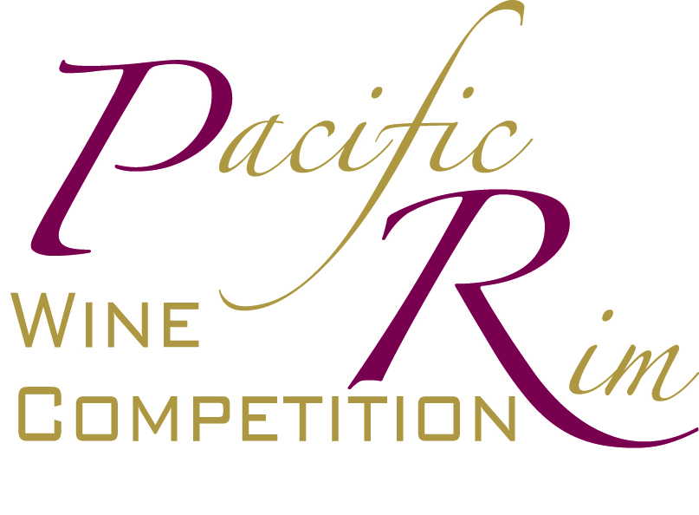
BRAND ACHIEVEMENT
The taste that CRITICS love!
1 Internal Gallo PR (Awards & Logos)

Slide 6
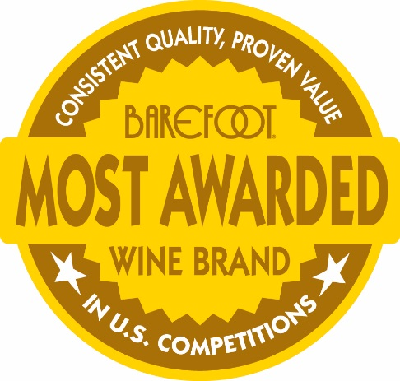
MOST AWARDED WINE BRAND
The MOST HIGHLY AWARDED
Still Wine Brand in US Competitions
The MOST HIGHLY AWARDED
Sparkling Wine Brand in US Competitions
and
Regardless of price point!!!
California, Australia, Argentina, & Spain Table Wine, ©2013 Barefoot Cellars, Modesto, CA. All rights reserved.

Slide 7
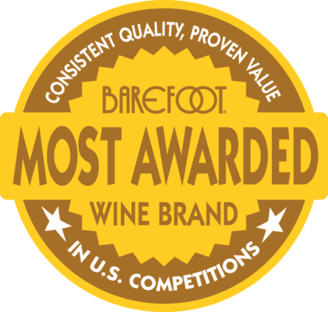
MOST AWARDED WINE BRAND
1192 medals & awards and counting

Slide 8
Our Tone of Voice
We are:
Fun
Friendly
Playful
Clever
Relaxed
Smart
Casual
We are not:
Mean
Crass
Basic
Oddball
Forced
Fussy
Loud

Slide 10
MOSCATO
#1 Moscato In Table Wine¹
Barefoot Moscato Is Outpacing The Table Wine Category In Both Dollar And Volume Sales Growth¹
Barefoot Moscato As A Total Varietal Brings In More New Wine Users Than Any Other Brand Varietal²
TASTING NOTES
Sweet, Tangerine & Floral
BAREFOOT IS THE MOST AWARDED WINE BRAND³
DOUBLE GOLD
and Class Champion!
2016 Indy Int. Wine Competition
DOUBLE GOLD!
2016 San Francisco Chronicle Wine Competition
GOLD and 90 Points!
2017 Monterey Wine Competition
IRI. Total US Mulo. Latest 52 Weeks Ending 6.25.2017. Total Table Wine by Brand. Dollar and Volume Sales . Filtered Moscato
IRI National Consumer Panel, Total US All Outlets, 52 Weeks ending 12-25-2016, Table Wine, Buyer Flow Dollars, New Buyers. 750ml+1.5L.
Internal PR Department ©2017 Barefoot Cellars, Modesto, CA. All rights reserved.
750ml: 008500001668
1.5L: 008500001667
187ml: 008500000559

Slide 11
CABERNET SAUVIGNON
Outpacing Popular Category Dollar And Volume SalesTrends¹
Barefoot Cabernet Sauvignon Is +80% Lift In Dollar Sales When Featured/Displayed²
More Barefoot Cabernet Sauvignon Consumers Repeat 5X+ Compared to Other Top Popular Brands³
TASTING NOTES
Velvety, Smooth, & Blackberry
BAREFOOT IS THE MOST AWARDED WINE BRAND⁴
GOLD!
2017 Great American Wine Competition
GOLD!
2017Hilton Head Wine Competition
DOUBLE GOLD!
2016 Tasters Guild Wine
IRI. Total US Mulo. Latest 52 Weeks Ending 6.25.2017. Total Table Wine by Brand. Dollar Sales and Volume Sales vs. YA. Filtered Cabernet Sauvignon
IRI. Total US Mulo. Latest 52 Weeks Ending 6.25.2017. Total Table Wine by Brand. % Increase in Dollars By Merch when Featured and Displayed. Filtered Cabernet Sauvignon.
© IRI National Consumer Panel, Total US All Outlets, 52 Weeks ending 12-25-2016, Trial and Repeat Brands: Woodbridge, Yellow Tail, Sutter Home and Beringer 4)Internal PR Department . ©2017 Barefoot Cellars, Modesto, CA. All rights reserved.
750ml: 001834175101
1.5L: 001834115101
187ml: 008500000521

Slide 12
MERLOT
#2 Merlot In Total Table Wine In Dollar Sales¹
Barefoot Merlot Is +72% In Dollar Sales When On Feature/Display²
More Barefoot Merlot Consumers Repeat 5X+ Compared to Other Top Popular Brands³
TASTING NOTES
Smooth, Light Oak, & Blueberry
BAREFOOT IS THE MOST AWARDED WINE BRAND⁴
GOLD!
2016 Wine Lovers International Wine Judging
GOLD!
2016 San Francisco Chronicle Wine Competition
GOLD and 90 POINTS!
2016 Toast of the Coast Wine Competition
IRI. Total US Mulo. Latest 52 Weeks Ending 6.25.2017. Total Table Wine by Brand. Dollar Sales . Filtered Merlot
IRI. Total US Mulo. Latest 52 Weeks Ending 6.25.2017. Total Table Wine by Brand. % Increase in Dollars By Merch when Featured and Displayed. Filtered Merlot.
© IRI National Consumer Panel, Total US All Outlets, 52 Weeks ending 12-25-2016, Trial and Repeat. Brands: Woodbridge, Yellow Tail, Sutter Home and Beringer
Internal PR Department ©2017 Barefoot Cellars, Modesto, CA. All rights reserved.
750ml: 001834175110
1.5L: 001834115110
187ml: 008500000546

Slide 13
RED MOSCATO
The #1 Red Moscato In Table Wine Representing 65% Of The Red Moscato Category¹
Barefoot Red Moscato is +55% when on Feature/Display²
11% Of All New Table Wine Users Enter Through Barefoot’s Moscato Portfolio³
TASTING NOTES
Sweet, Red Berry, & Floral
BAREFOOT IS THE MOST AWARDED WINE BRAND⁴
DOUBLE GOLD!
2016 Indy International Wine Competition
GOLD!
2017 San Francisco Chronicle Wine Competition
GOLD!
2016 Denver Wine Competition
IRI. Total US Mulo. Latest 52 Weeks Ending 6.25.2017. Total Table Wine by Brand. Dollar Sales . Filtered Red Moscato
IRI. Total US Mulo. Latest 52 Weeks Ending 6.25.2017. Total Table Wine by Brand. % Increase in Dollars By Merch when Featured and Displayed. Filtered Red Moscato.
IRI National Consumer Panel, Total US All Outlets, 52 Weeks ending 12-25-2016, Table Wine, Buyer Flow Dollars, New Buyers
Internal PR Department. ©2017 Barefoot Cellars, Modesto, CA. All rights reserved.
750ml: 008500001989
1.5L: 008500002028
187ml: 008500000185

Slide 14
SWEET RED
#1 Sweet Red In Table Wine¹
BFC Sweet Red brings in more than double the volume and revenue as the next closest competitor
TASTING NOTES
Smooth, Sweet, & Red Fruit
BAREFOOT IS THE MOST AWARDED WINE BRAND²
GOLD!
2016 Denver Intl Wine Competition
GOLD!
2016 Lone Star Intl Wine
GOLD!
2016 Toast of the Coast Wine Competition
) IRI. Total US Mulo and Sum of Liquor. Latest 52 Weeks Ending 7.30.2017.
) Internal PR Department ©2017 Barefoot Cellars, Modesto, CA. All rights reserved.
750ml: 008500001849
1.5L: 008500001868
187ml: 008500000573

Slide 15
SAUVIGNON BLANC
#2 Sauvignon Blanc In The Popular Category¹
Barefoot Sauvignon Blanc is on Fire
Revenue +9.22%¹
Volume +11%¹
TASTING NOTES
Crisp, Lime, & Aromatic
BAREFOOT IS THE MOST AWARDED WINE BRAND²
GOLD!
2016 San Fransisco Chronicle Wine
GOLD!
2016 San Diego Intl Wine Challenge
GOLD!
2016 Sommelier Challenge (Wine)
) IRI. Total US Mulo and Sum of Liquor. Latest 52 Weeks Ending 7.30.2017.
) Internal PR Department ©2017 Barefoot Cellars, Modesto, CA. All rights reserved.
750ml: 001834175102
1.5L: 001834115102

Slide 16
IN-TOE-DUCING…
NEW BAREFOOT SANGRIA!
Sangria is a hot growth flavor and has been growing over the past 5 years
TASTING NOTES
Flavorful, Berry, & Citrus
Sangria consumers are looking to try new entrants
Barefoot is the #1 Wine Brand that now offers a fruit forward Sangria!
NEW Barefoot Sangria has All Natural Fruit Flavors!
Capitalize on the Sangria sales all summer long with NEW Barefoot
Sangria eye catching POS!
RIPE & JAMMY
R/S:5.8%
FRUITY & JUICY
R/S:6.5%
JUICY & SWEET
R/S:7.5%
BRIGHT, LIVELY & SWEET
R/S:10%
DRY
SWEET
Pinot Noir, Zinfandel, and Tempranillo | Moscato Blended with Pinot Noir | Tempranillo, Barbera, and Carnelian | Malbec Rose, Pinot Noir and Zinfandel
Pleasant aromas of raspberry and plum with blueberry flavors complement for a soft & smooth finish. | Mandarin orange, tangerine and orange blossom flavors excite the palate. Tart red raspberry and ripe dark cherry beautifully complement the blend. | Beautifully balanced with layers of all natural orange, lemon, and lime flavors. Finishes with a hint of grapefruit & pineapple and the sweet lime finish. | Loaded with flavors of cherries and strawberry jam. Layers of floral notes & spice complement the silky smooth texture and sweet lingering finish
IRI Total US MULO Plus Sum of Liquor. Latest 52 weeks ending 5/22/2016
California, Australia, Argentina, & Spain Table Wine, ©2014 Barefoot Cellars, Modesto, CA. All rights reserved.
750ml: 008500002505

Slide 17
PINK MOSCATO
#1 Pinot Grigio In Table Wine¹
Barefoot Pink Moscato Is Growing At Double The Rate Of The Table Wine Category ¹
Barefoot Pink Moscato 750 ml Brings In More New Wine Users Than Any Other SKU In Table Wine²
TASTING NOTES
Sweet, Raspberry, & Floral
BAREFOOT IS THE MOST AWARDED WINE BRAND³
DOUBLE GOLD!
2016 San Francisco Chronicle Wine Competition
GOLD!
2016 Toast of the Coast Wine Competition
DOUBLE GOLD!
2016 California State Fair Wine Competition
IRI. Total US Mulo. Latest 52 Weeks Ending 6.25.2017. Total Table Wine by Brand. Dollar Sales . Filtered Pink Moscato
IRI National Consumer Panel, Total US All Outlets, 52 Weeks ending 12-25-2016, Table Wine, Buyer Flow Dollars, New Buyers.
Internal PR Department ©2017 Barefoot Cellars, Modesto, CA. All rights reserved.
750ml: 008500002045
1.5L: 008500002060
187ml: 008500000594

Slide 18
©2017 Barefoot Cellars, Modesto, CA. All rights reserved.

